Slide 1
_{USE CASE: 3.2}

Slide 2
Problem Statement:
Build a sentiment analysis model to analyze customer reviews ans feedback for a hospitality company. The model should be able to classify reviews as positive, negative, or neutral, and identify key topics or areas of concern.
Solution Pipeline:
Exploratory Data Analysis (EDA):
Explored the dataset to gain insights into review distributions and identify key topics or concerns.
Cleaned the data and visualized important features to inform subsequent model building.
Model Building with Word2Vec:
Utilized Word2Vec embeddings to capture semantic relationships between words in the text data.
Trained the Word2Vec model on the review text to create word embeddings for use in classification models.
Classification Models:
Implemented various classification algorithms, including logistic regression, random forest, and SVM, using Word2Vec embeddings.
Evaluated the performance of each model in classifying reviews into positive, negative, or neutral sentiment categories.
LSTM Model:
Developed a Long Short-Term Memory (LSTM) neural network model for sentiment analysis.
Leveraged Word2Vec embeddings to represent text data and trained the LSTM model to predict sentiment labels.

Slide 3
Model Evaluation:
In this evaluation, i assessed the performance of different machine learning models based on accuracy.
Our findings revealed varying levels of accuracy:
Logistic Regression: Achieved an accuracy of 70%.
LSTM: Attained a performance of 72%.
XGBoost: Emerged as the top performer with an accuracy of 75%.
These accuracy scores reflect the models' effectiveness in correctly classifying sentiments within our dataset.

Slide 4
Deployment
In addition to model evaluation, deployment is a crucial aspect of the project lifecycle.
After thorough evaluation, we deployed the XGBoost model, which demonstrated the highest accuracy of 75%.
The deployment process involved integrating the model into a user-friendly interface for real-world applications.
We utilized Streamlit, a powerful Python library, to develop an interactive web application.
The deployed application allows users to input text and receive sentiment predictions instantaneously.

Slide 5
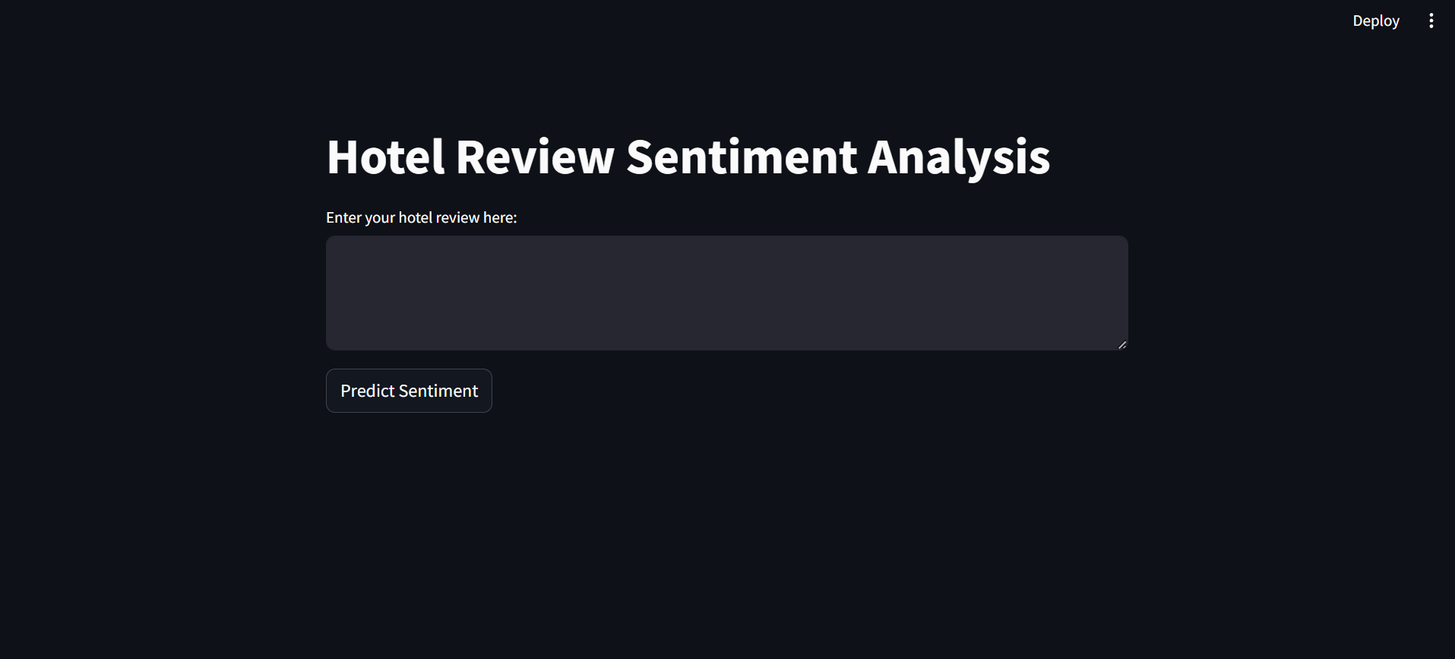
Deployment

Slide 6
Conclusion:
In conclusion, my evaluation showcased the effectiveness of machine learning models in sentiment analysis.
XGBoost exhibited the highest accuracy of 75%, surpassing other models.

